Slide 1
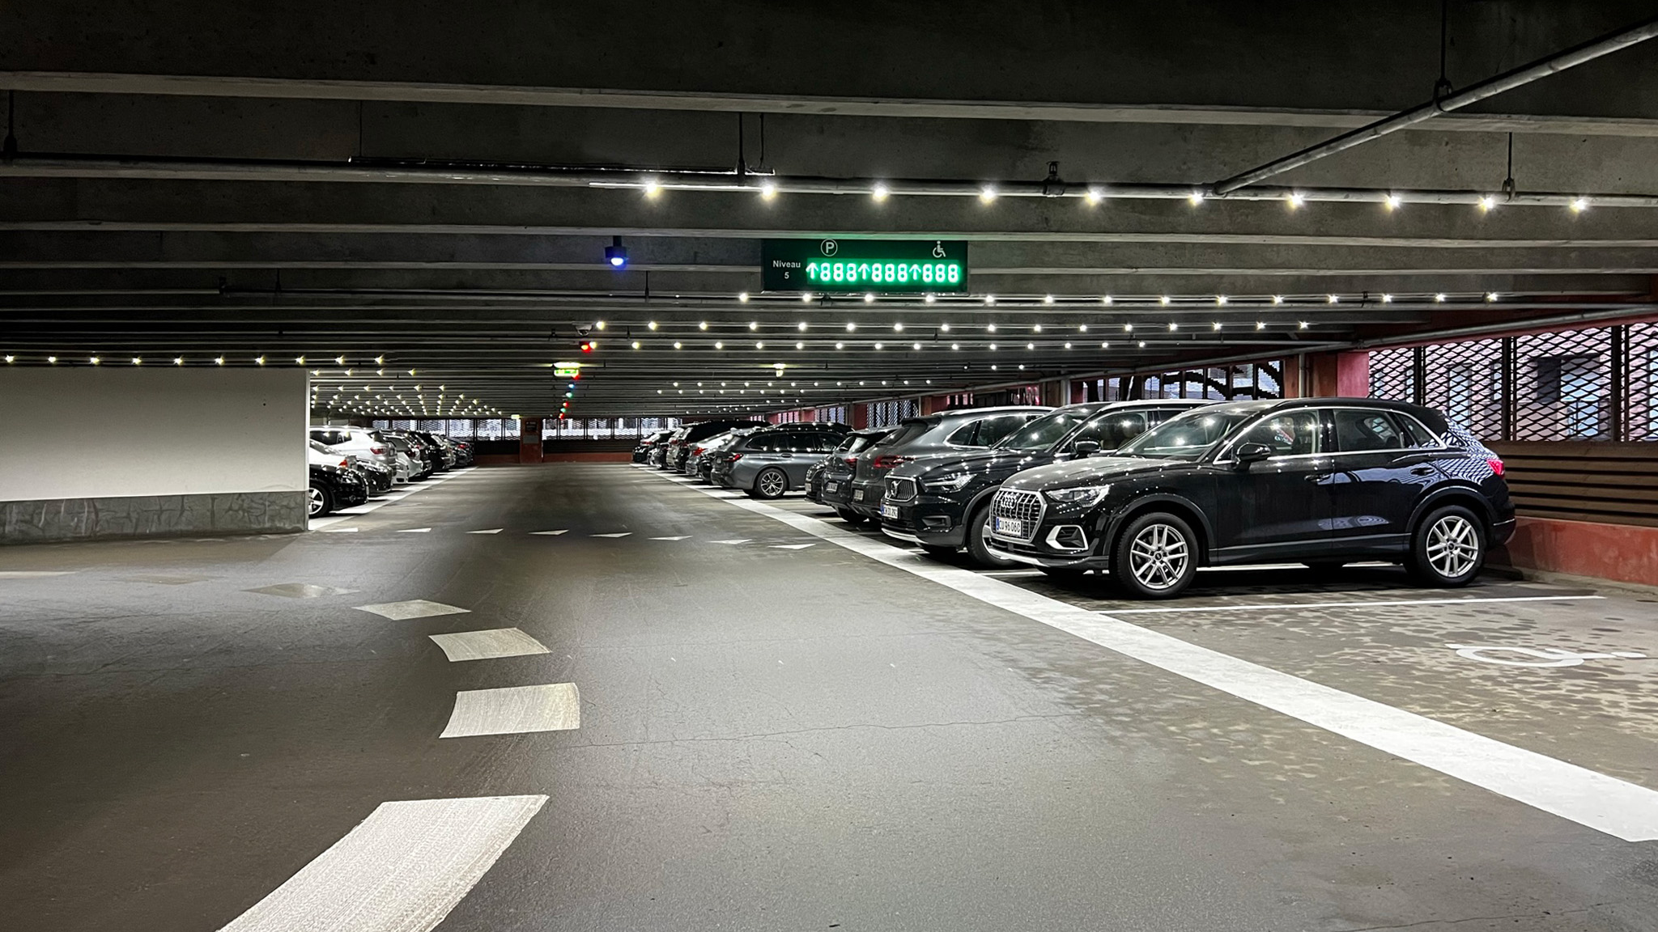






Parking Lighting Solutions
For safety and experience
The slim 6 mm TRACY® LED-panels are available in 20 optional colors
IP67
Weather, water and dust resistant aluminum panels and glass protected LEDs designed for rough environments
Excellent uniform light distribution
218 lumen per spot
Color-range 2750K - 6500K
Adjustable light, lux and lumen with LED iBond Light Management system and most lighting control systems e.g., DALI
Market leading product lifespan.
High quality solution designed and manufactured in Denmark
Easy installation with click-on mounting and less cables in lengths up to 100 meters per Power Source Unit
LIGHTING AS AN INTEGRATED PART
OF THE CONSTRUCTION
Click
Reduced climate impact with energy efficient LEDs in recycable aluminum panels and less plastic
Made in Denmark by
Photo: Lüders Parking House, Copenhagen

